Slide 1
www.SeeItStopIt.org

Slide 2
What is it?
The See it? Stop it! initiative empowers employees to speak up if they witness animal abuse, neglect, harm or mistreatment.
See it? Stop it! confirms the culture of care that farm owners and managers demand of every person who comes in contact with their animals. It highlights the integrity of the farm’s philosophies on responsible animal care, helps staff understand their important role in animal protection and provides clear direction on how to report instances of animal abuse, neglect, harm or mishandling.
Funding for See it? Stop it! Is provided by:

Slide 3
Objectives
Raise Awareness
Confirm the importance of proper animal care by introducing initiative principles to all employees.
Empower Employees
Provide employees with training and resources that support the farm’s participation in the initiative.
Take Action
Investigate reports and take corrective action.
Deliberate actions result in immediate suspension, termination, enforcement and appropriate consequences.
Retrain when there are any care concerns; implement appropriate probationary period to ensure performance of duties responsibly.

Slide 4
Values of the Initiative
Animal abuse, neglect, harm and mishandling are unacceptable and will not be tolerated.
Proper animal care is the responsibility of every individual who is around animals.
Individuals working with or around animals have an obligation to immediately report any signs of deliberate animal abuse, neglect, harm or mishandling to a supervisor or other individual responsible for enforcement of proper animal care.
Thorough, ongoing and consistent employee training and re-training are critical to responsible animal care and are necessary components of a comprehensive animal care program.

Slide 5
Values of the Initiative (cont.)
Employers have an obligation to:
Provide education and promote the importance of proper and responsible animal care.
Encourage and enable employees to immediately report of all signs of animal abuse, neglect, harm or mishandling.
Provide accessible and reliable contacts who have immediate authority to address reports of animal care concerns.
Take swift action to correct all instances of inappropriate animal care.
Ensure employees who raise concerns in good faith are not penalized.

Slide 6
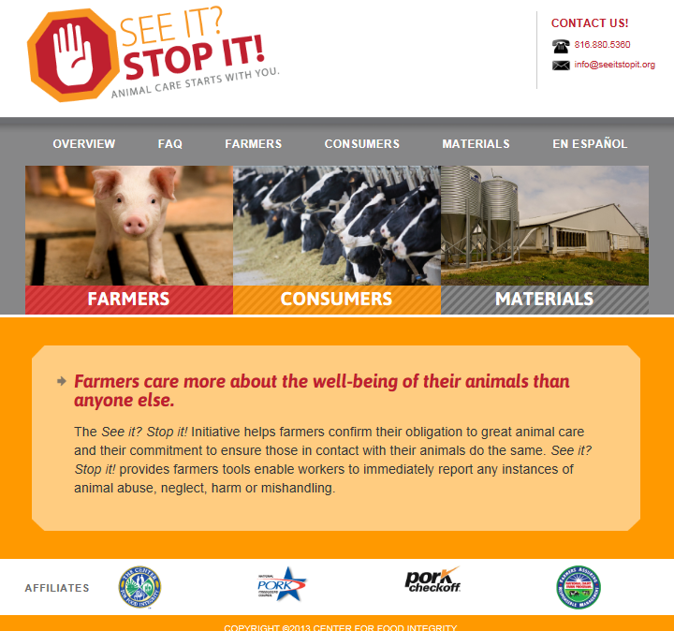
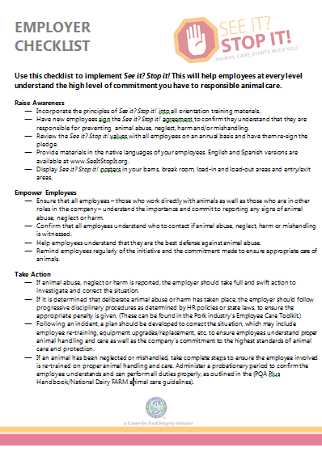
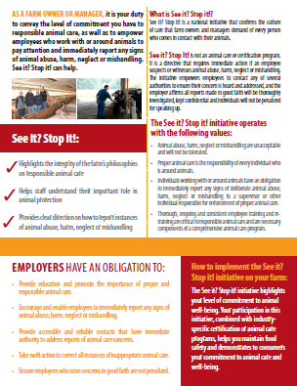
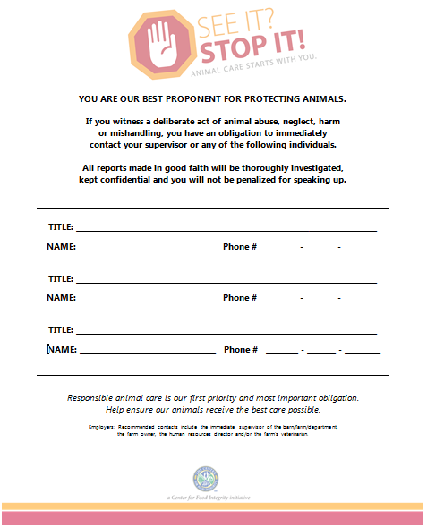
Materials: English & Spanish
Brochure
Posters
Overview
Employer Checklist
Employee Agreement
Website (March launch)
Press release

